Slide 1
Theory of Evolution Through Natural Selection
Pubudu Ediriweera and Samuel-Bar Ari

Slide 2


Slide 3

Content
Syllabus Points
Natural Selection and Evolution
Components of Natural Selection
Variation
Overpopulation
Competition
Selection
Examples of natural selection in humans
Sickle-cell anaemia
Body stature

Slide 4
Syllabus Points
“Natural selection occurs when factors in the environment confer a selective advantage on specific phenotypes to enhance survival and reproduction”
“The mechanisms underpinning the theory of evolution by natural selection include inherited variation, struggle for existence, isolation and differential selection, producing changes to gene pools to such an extent that speciation occurs”

Slide 5
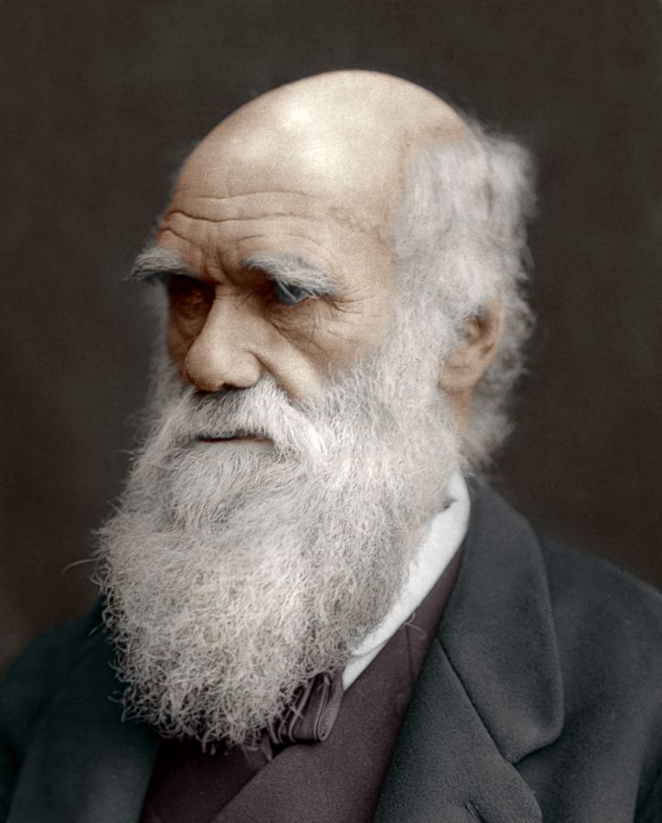
Natural selection and evolution #1
Who came up with the idea of Natural selection?
His idea of Natural Selection also forwarded the idea of evolution
Evolution = gradual change in the characteristics of a species
CHARLES DARWIN!!

Slide 6
Natural selection and evolution #2
Natural selection
Resources are limited in nature
Organisms with heritable traits that favour survival and reproduction will tend to leave more offspring than their peers
Traits would increase in frequency over generations
Causes populations to become adapted to their environments over time
Dependent on the environment and requires existing heritable variation in the population

Slide 7
Components of natural selection
How does natural selection occur:
Darwin made several observations in his travels to the Galapagos archipelago (Islands isolated from South America) about the wildlife on those islands:
Variation – All members of a species varied and those variations passed on from one generation to another
Birth rate – All living organisms reproduced faster than the availability of resources
Nature’s balance – Despite the high birth rate of organisms, the species’ numbers were tend to keep at a relative constant

Slide 8

Components of natural selection
This brings about the components of natural selection which cause evolution to occur:
Variation
Overproduction
Competition
Selection

Slide 9
Components of natural selection - Variation
The offspring in any generation will be slightly different from one another in their traits (colour, size, shape, etc.), and many of these features will be heritable.
This means that all members in a species vary due to the combinations of alleles passed on to the offspring through these processes:
Random assortment
Mutations
Crossing over
Random fertilisation
Non-disjunction

Slide 10
Components of natural selection – Overproduction
This is when the birth rate of a species is higher than the available resources needed for all individuals to survive and reproduce.
This equals to a struggle for existence – aka competition
Example: Humans (by a lot):
Money
Food
Water
Shelter etc.

Slide 11
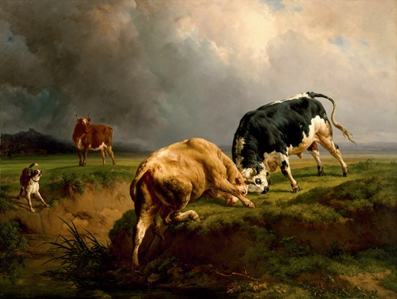

Slide 12
Components of natural selection - Competition
Competition (struggle for existence) - Organisms must struggle to get what they need to survive, competing against other organisms for the same resources available. They also have to struggle to get away from predators and to overcome disease.
Survival of the fittest – organisms with more favourable characteristics (variations) to their surroundings survive and reproduce to pass on their traits, while the less favourable ones die off and don’t pass on their traits.

Slide 13
Components of natural selection – Selection
Due to these selection pressures, traits that are favourable and enhance the chances of survival and reproduction, are selected for (over time) in the environment.
The alleles (favoured alleles) coding for the traits are thus, selected for and the frequency of these alleles would increase over time in that population.

Slide 14
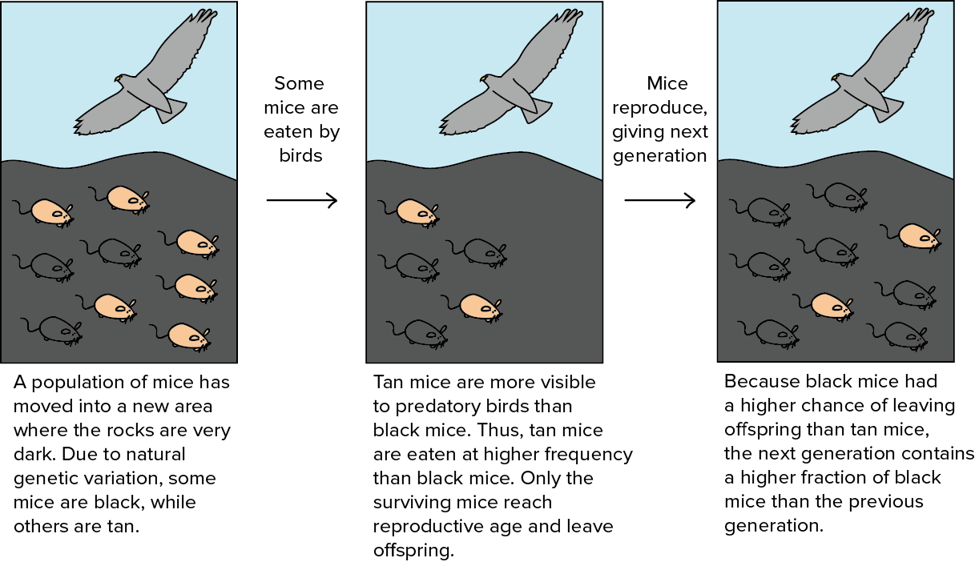

Slide 15

Examples of natural selection in humans – Sickle-cell anaemia #1
Sickle-cell anaemia – a disease that causes red-blood cells to have a sickle shape
Due to a mutation in the gene responsible for the production of haemoglobin
Disease is usually fatal in homozygote recessive individuals (ss)
But sickle-cell anaemia is still very prevalent in some areas around the world – WHY?

Slide 16
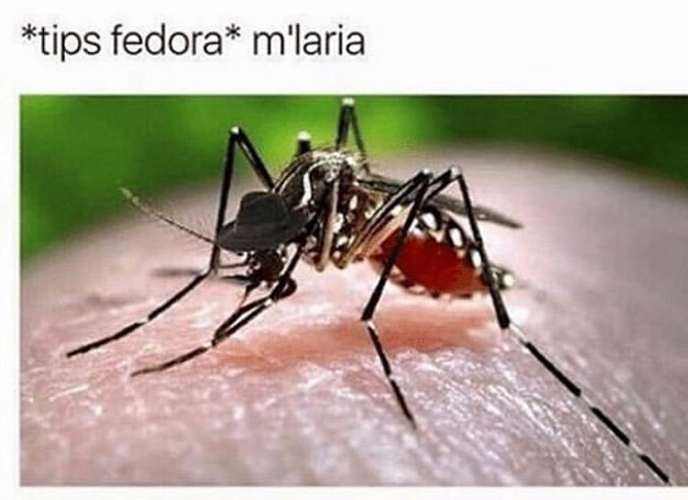
Examples of natural selection in humans – Sickle-cell anaemia #2
The heterozygote-variant (Ss) has some sickled cells and some normal red blood cells
Heterozygous (Ss) individuals are resistant to malaria compared to homozygous (SS) non-affected individuals
Malaria is said to be a selective agent (environmental factor acting on the population) for the sickle-cell allele - found in mosquito breeding areas such as large parts of Africa and Asia

Slide 17
Examples of natural selection in humans – Body Stature #1
Africans
Ectomorphic - Have long limbs and short bodies (evolution due to hot climates)
Larger surface area relative to body volume
Ability to disperse heat more efficiently

Slide 18
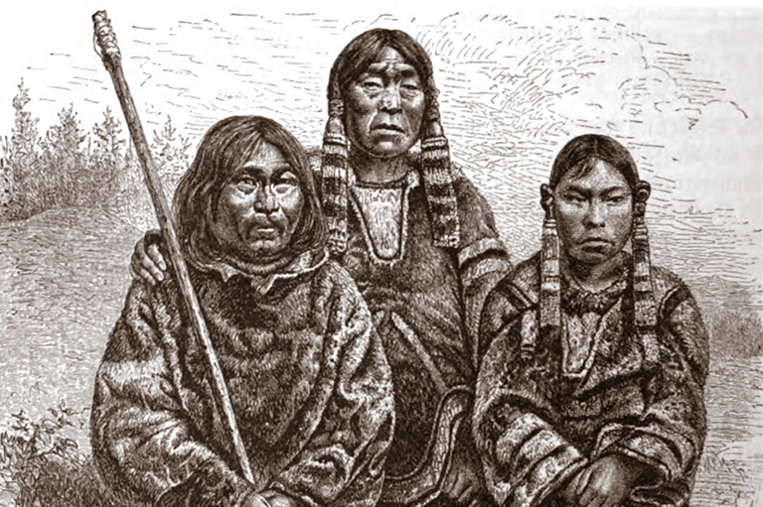
Examples of natural selection in humans – Body Stature #2
Inuits
Endomorphic - have short limbs and long bodies
Smaller surface area relative to body volume
Conserves body heat

